Slide 1
Mask placement apparatus
EECE 5552 Assistive Robotics Project Team 4:
Will Varner, Muralikrishna Shanmugasundaram, Damian Kulec, Tejas Krishna Reddy, Robin Yohannan, Xinchao Song
Notes:
Will

Slide 2
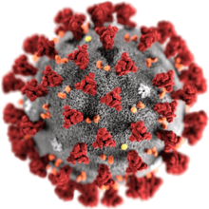
Introduction
Over 70,000,000 people worldwide have gotten COVID-19 in less than a year
Wearing masks can help prevent the spread of the virus
Masks don't need to be on all the time
Notes:
Will

Slide 3
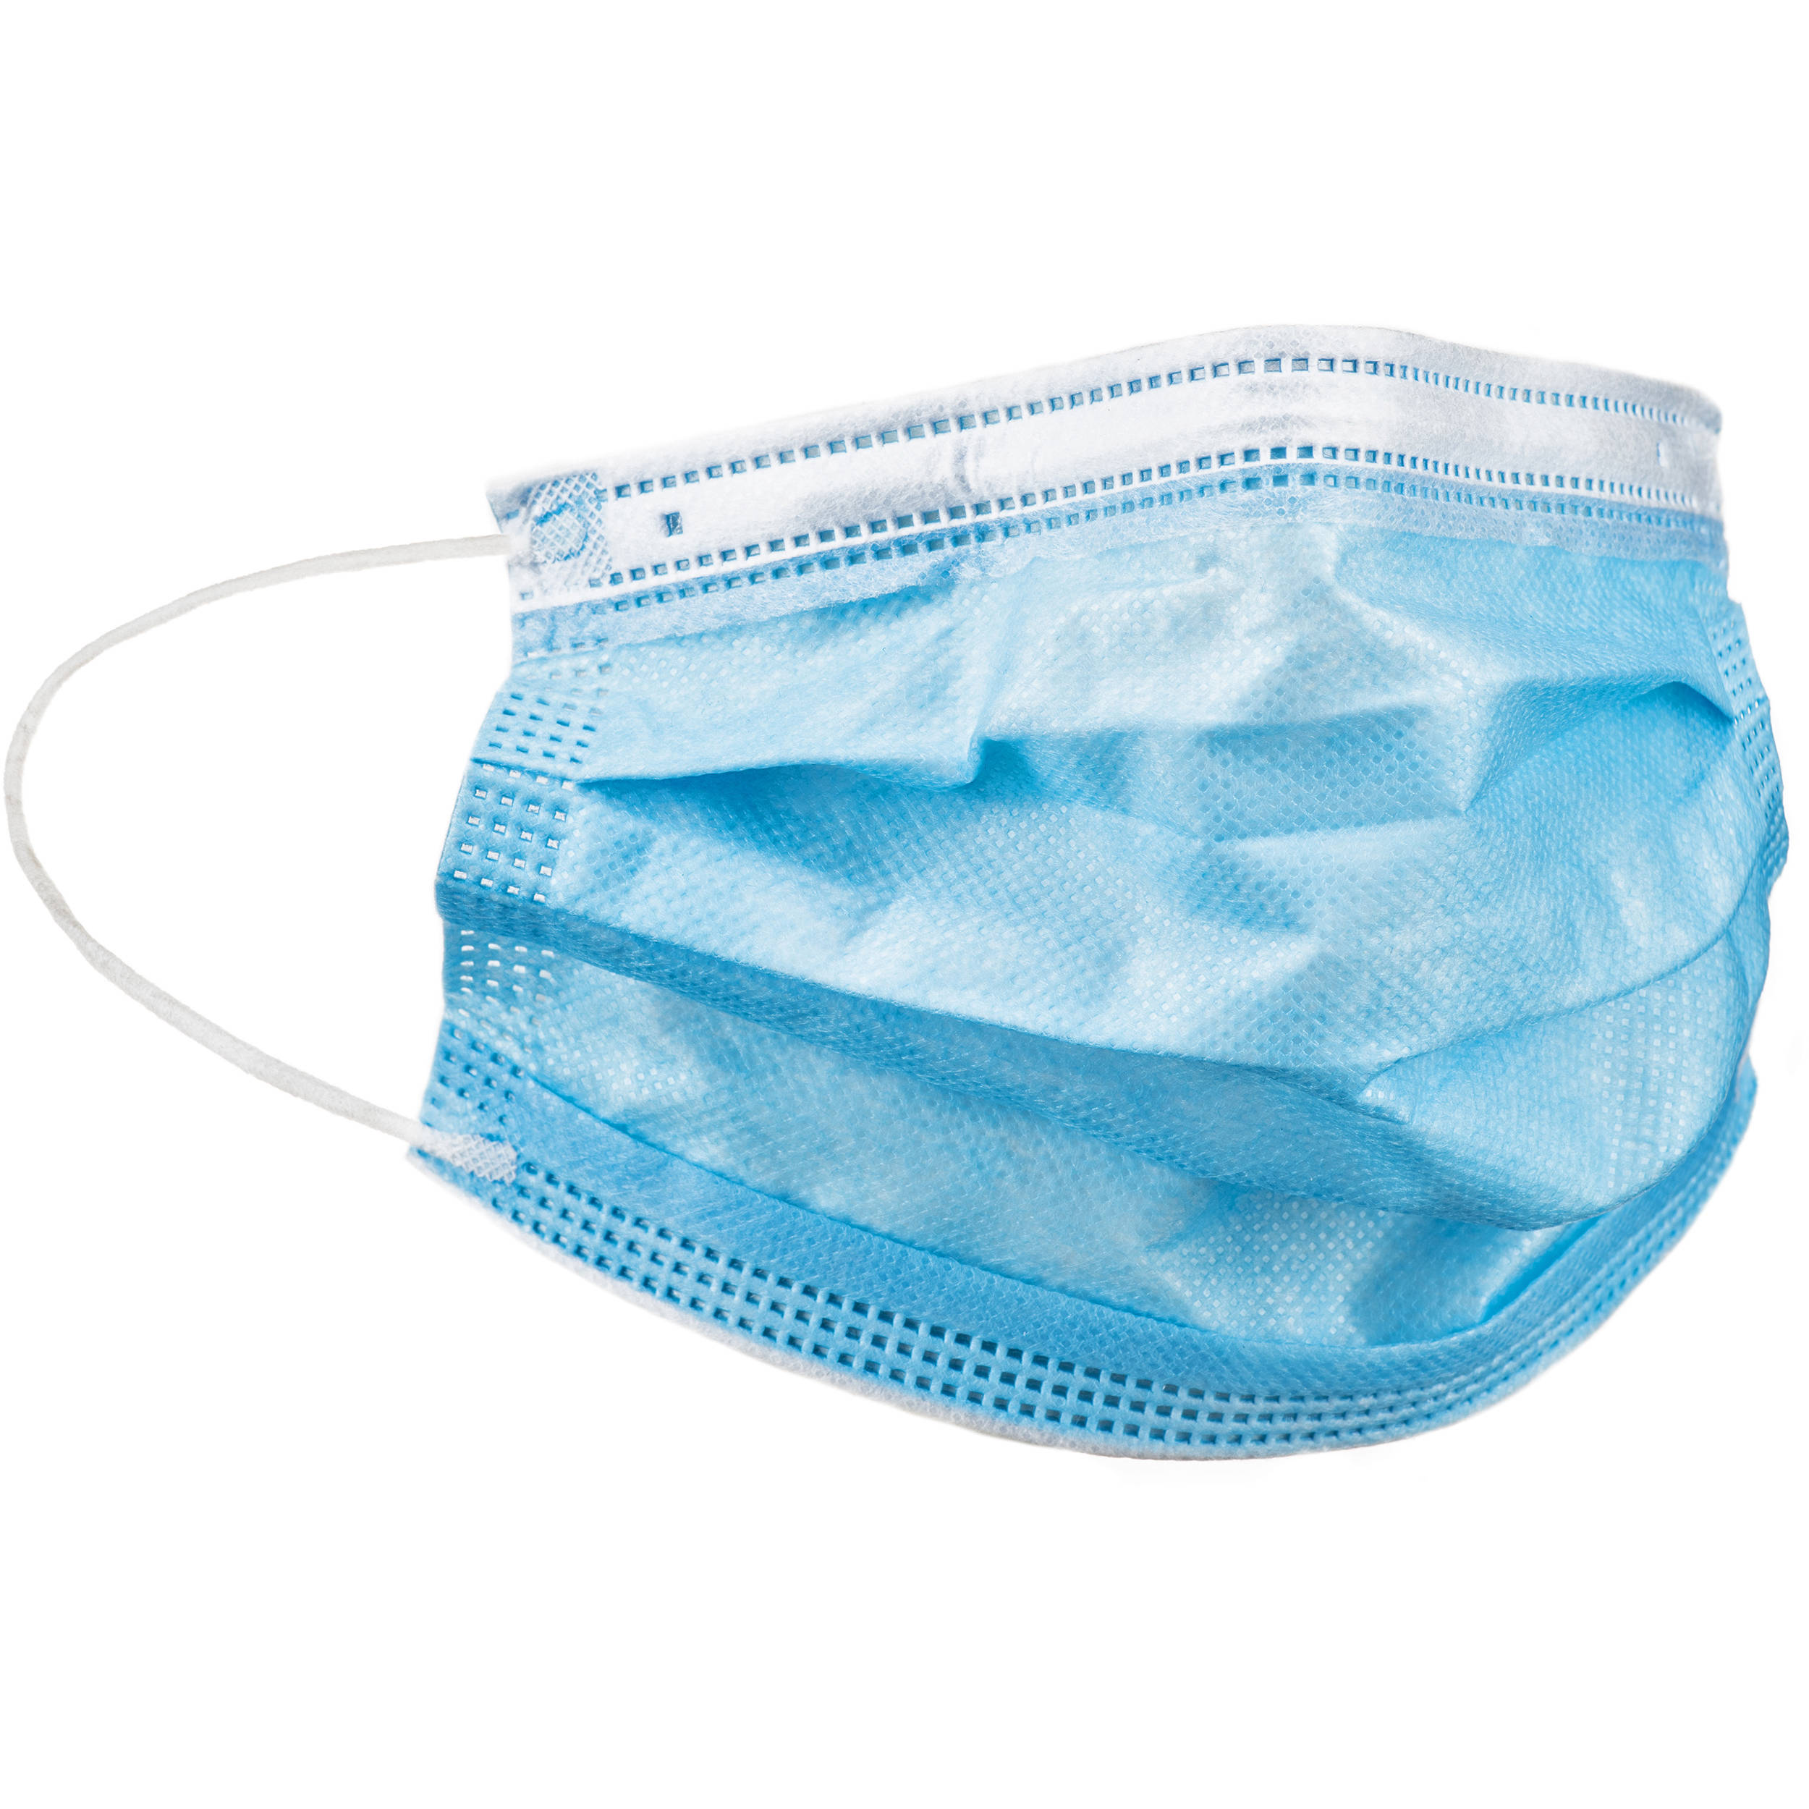
Problem Statement
People who suffer from mobility impairments cannot easily put on or take off COVID-19 masks
Notes:
Will

Slide 4
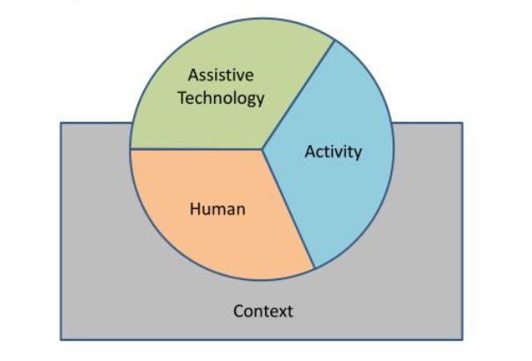
HAAT Model
A robotic arm mounted on top of the wheelchair for placing mask
People suffering from mobility impairment.
To safely interact/ co-work with other people during the time of covid-19
Both Indoor and outdoor, where exist another human in the environment
Notes:
Murali

Slide 5
Our approach
Simulation conducted with assistive-gym and PyBullet
Simulated user's head in different orientations and moved arm to match the head in each trial
Notes:
Damian

Slide 6
Hardware Requirements
An apparatus that successfully places/removes mask over person's face
Apparatus should take up minimal space
Apparatus must be of reasonable size & weight
Easy to control by user

Slide 7
Software Requirements
We will need a controller that can tell the apparatus to move when activated
Will require facial recognition software to determine how to move the apparatus

Slide 8
Implementation Features
Design
Software
Apparatus takes up minimal space
Apparatus location & size doesn't interfere with user
Easy to use
Facial recognition software successfully locates the user's face
The apparatus successfully places/removes the mask over the user's face
Notes:
Damian

Slide 9
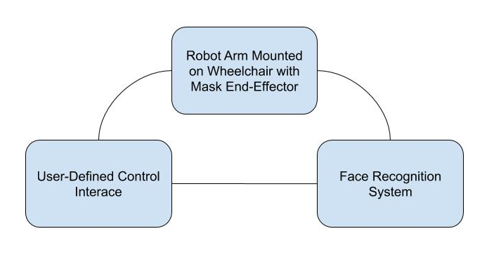
Design Overview
Notes:
Murali

Slide 10
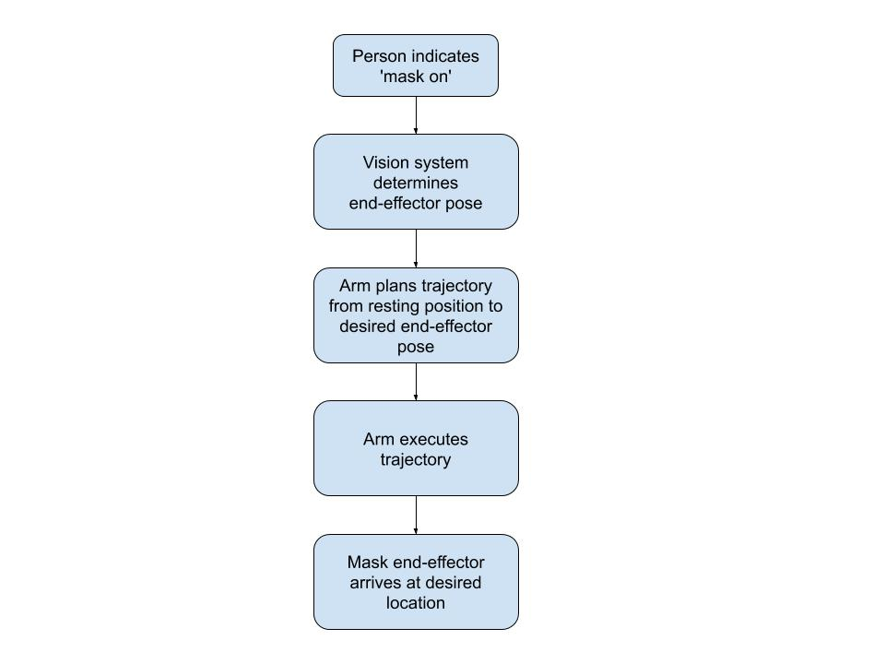
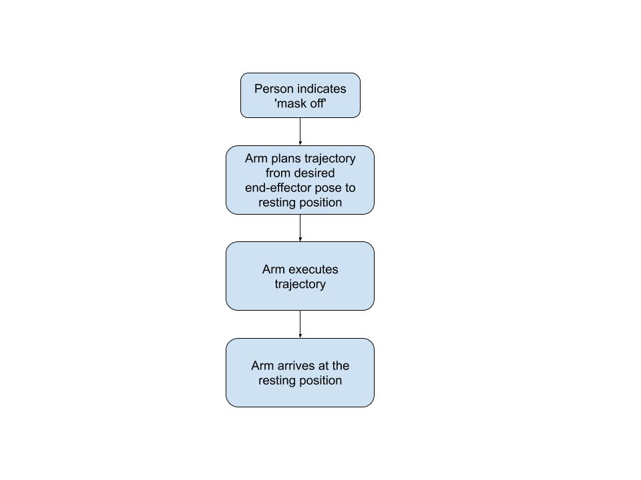
System Behaviors
Mask on
Mask off
Notes:
Murali

Slide 11
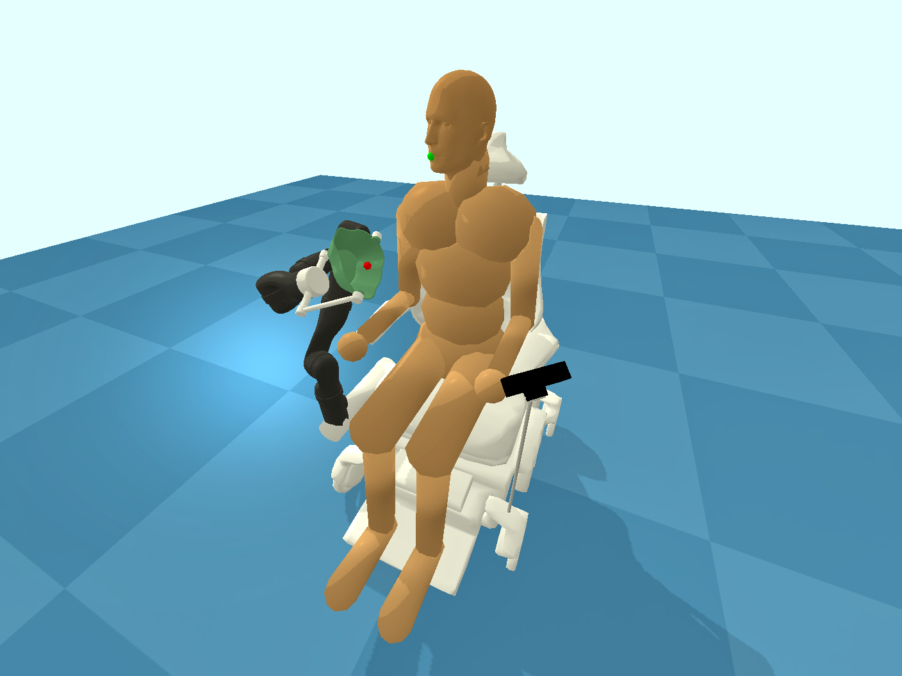
Simulation Environment
Mask Placement Apparatus in the simulator
Notes:
Robin

Slide 12
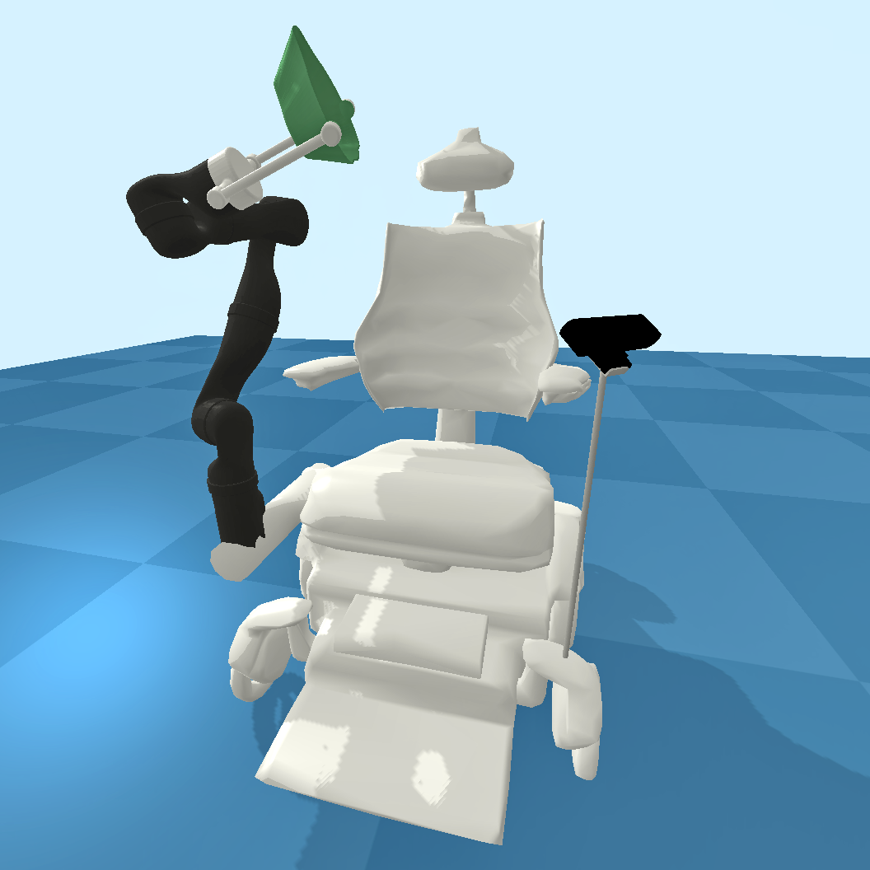
Overall Hardware Design
End Effector
Robot Arm
Camera
Wheelchair
Notes:
Robin

Slide 13
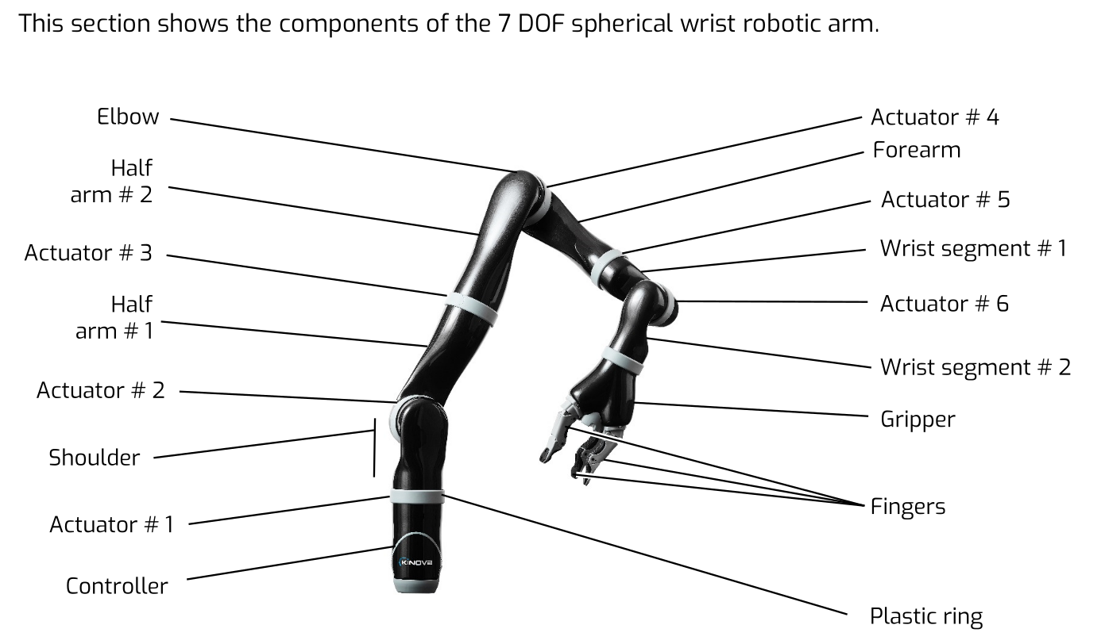
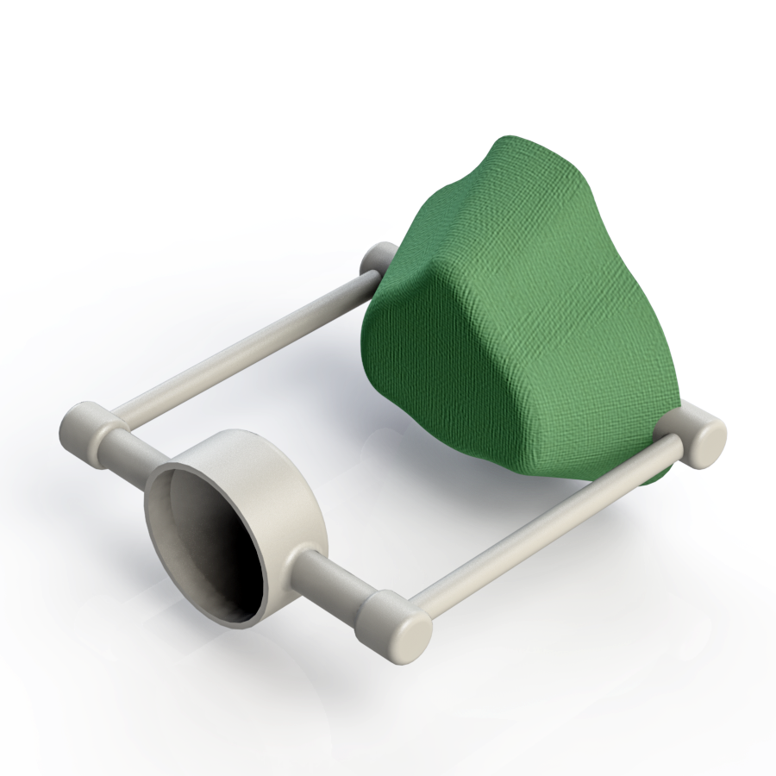
Robot Arm
Replace the gripper with our end effector
The configuration of the Kinova JACO 7 DOF robot arm (left) and our end effector (right)
Notes:
Xinchao

Slide 14
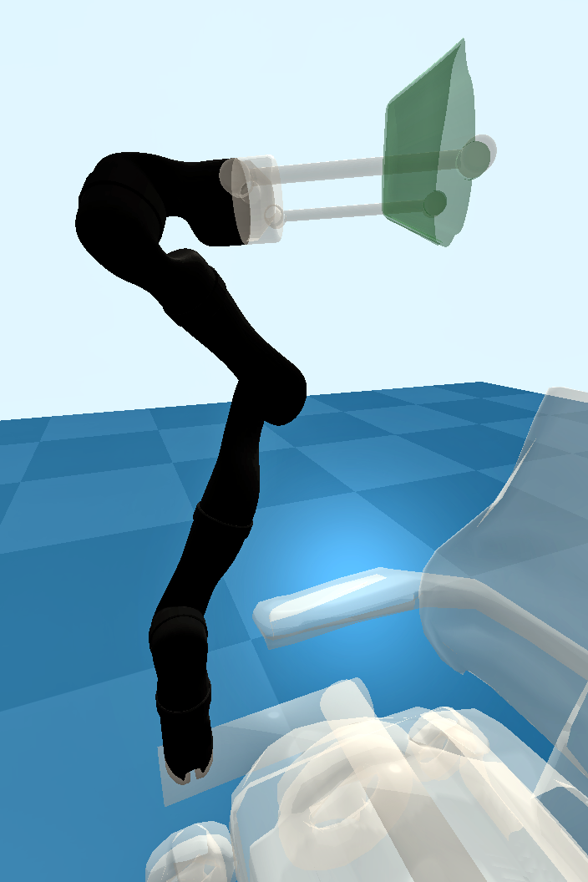
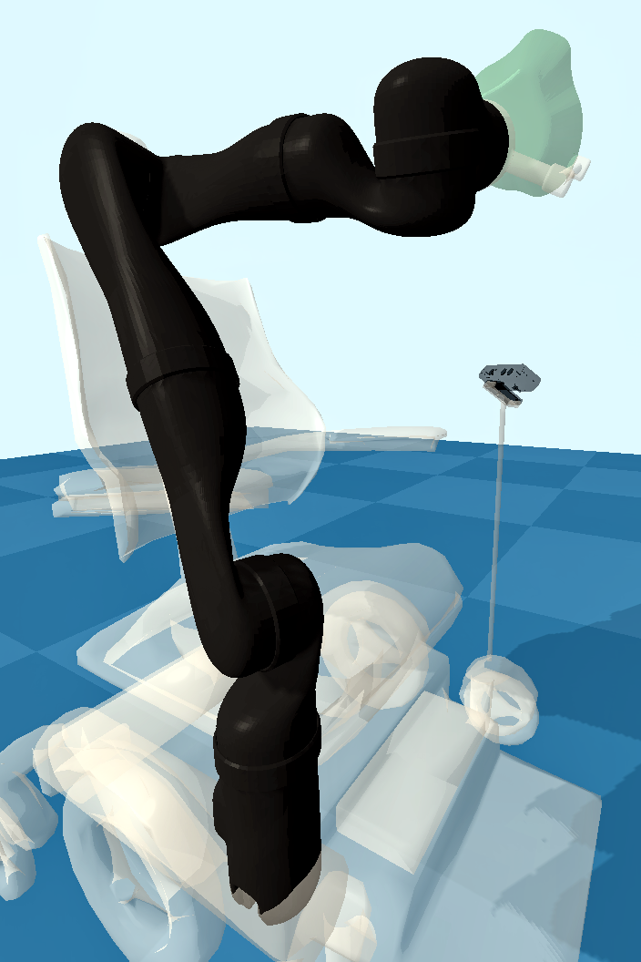
Robot Arm
Kinova JACO robot arm in simulation (attached to wheelchair)
Notes:
Xinchao

Slide 15
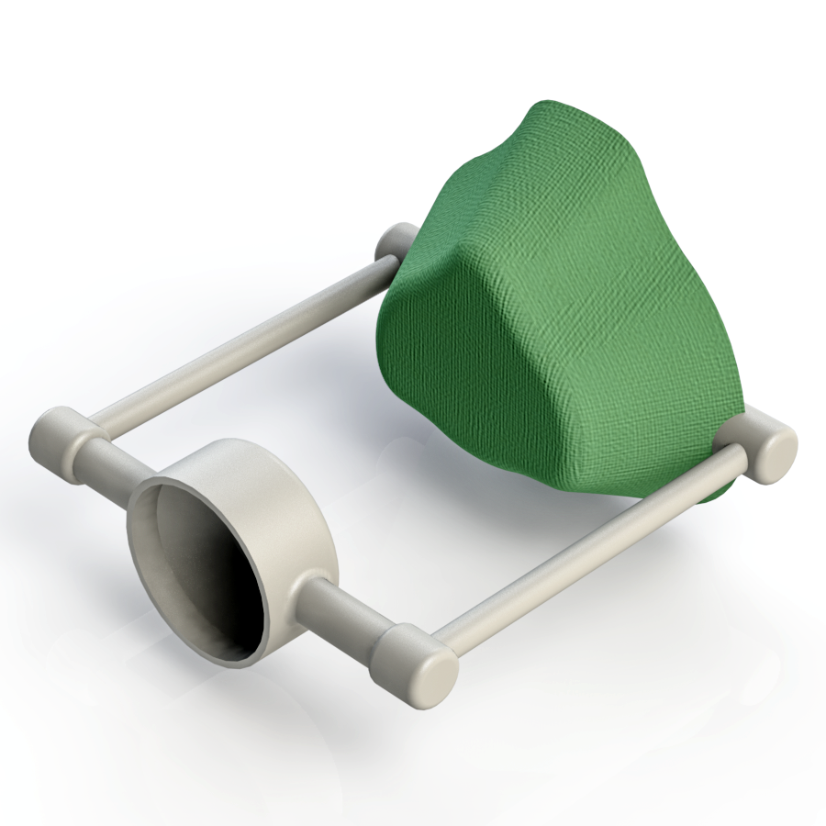
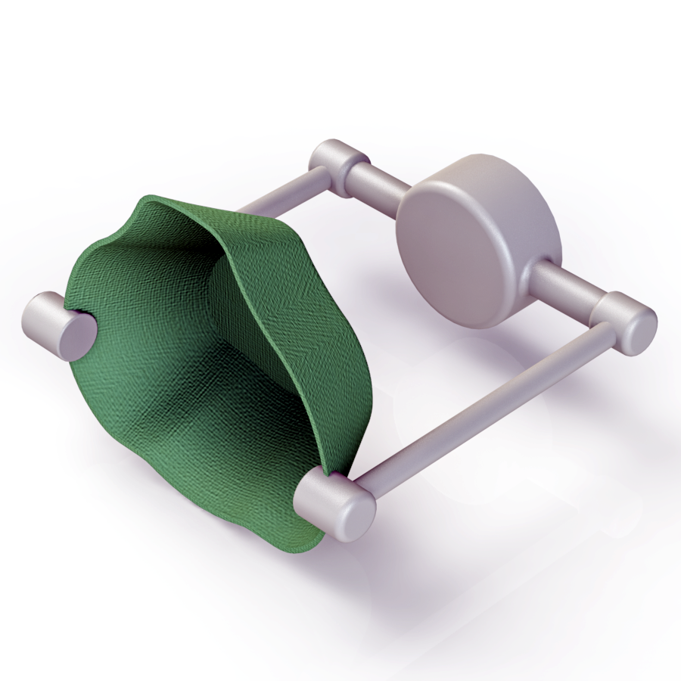
End Effector – Main Design
Mask
Holder
Notes:
Xinchao

Slide 16
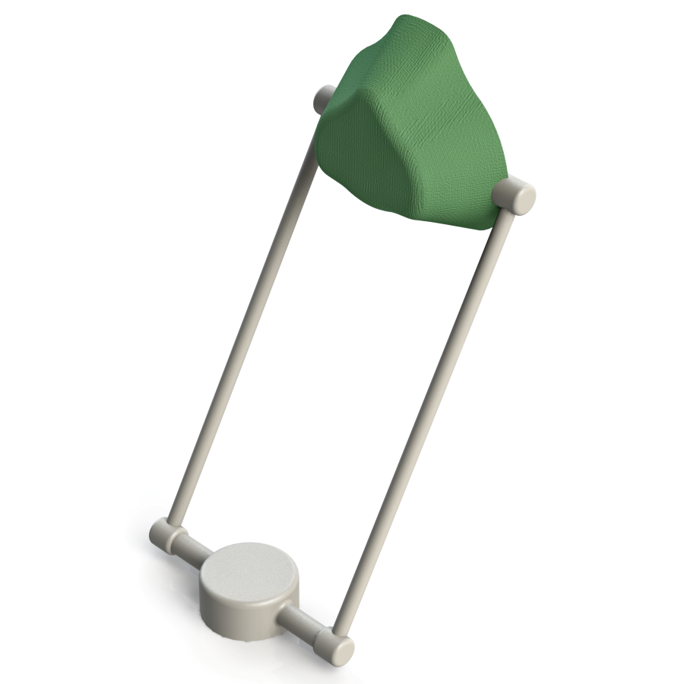
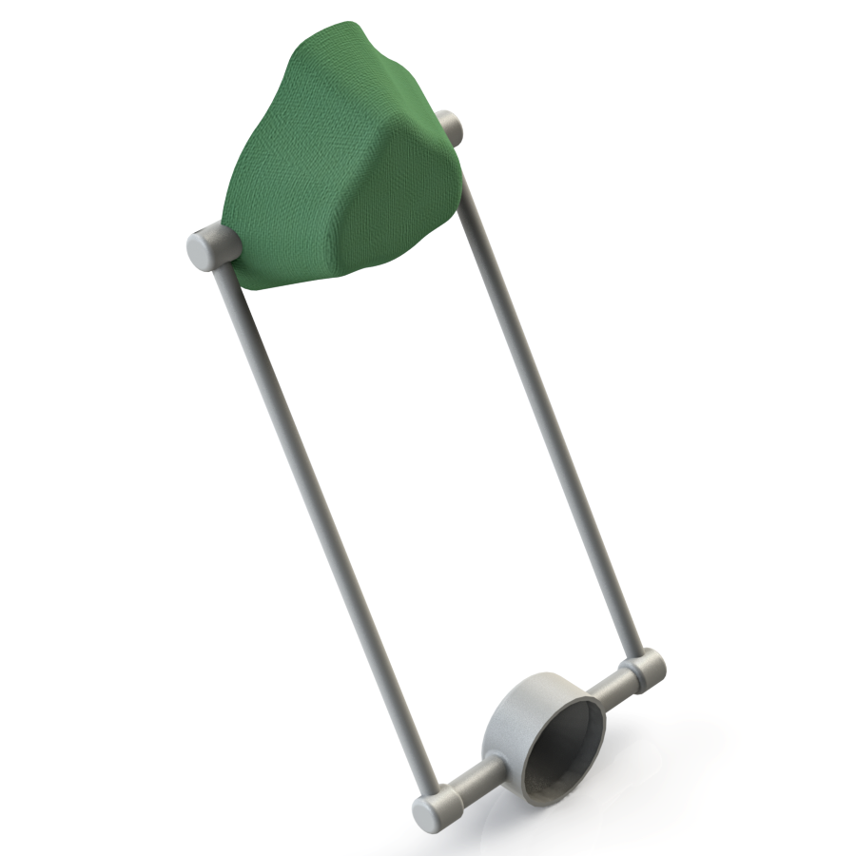
End Effector – Alternative Designs
Longer
rod
Longer
rod
60°
60°
Notes:
Xinchao

Slide 17
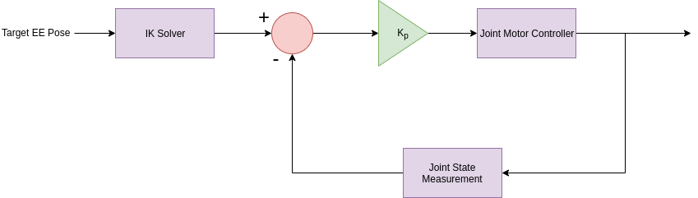
Arm Controller
Notes:
Robin

Slide 18
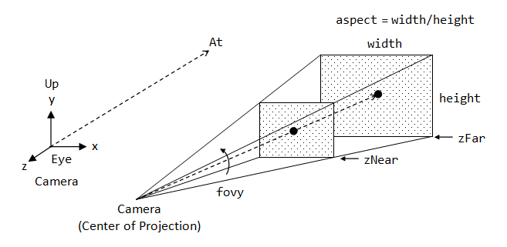
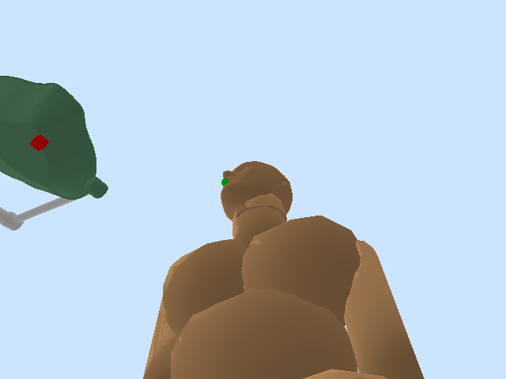
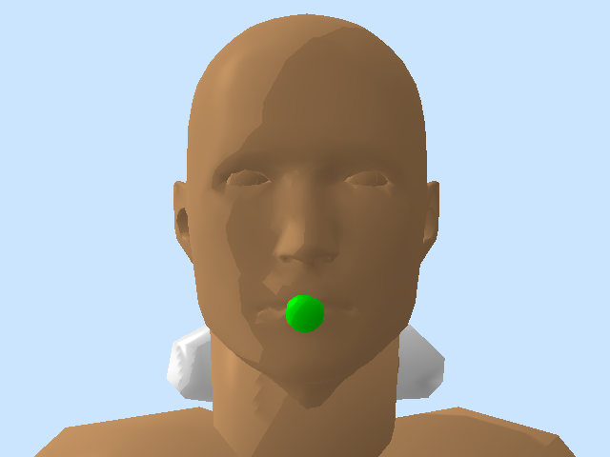
Simulated Camera
Figure 11. Camera field-of-view
Figure 12. Simulated camera image from left armrest
Figure 13. Simulated camera image from head-on
Notes:
Robin

Slide 19
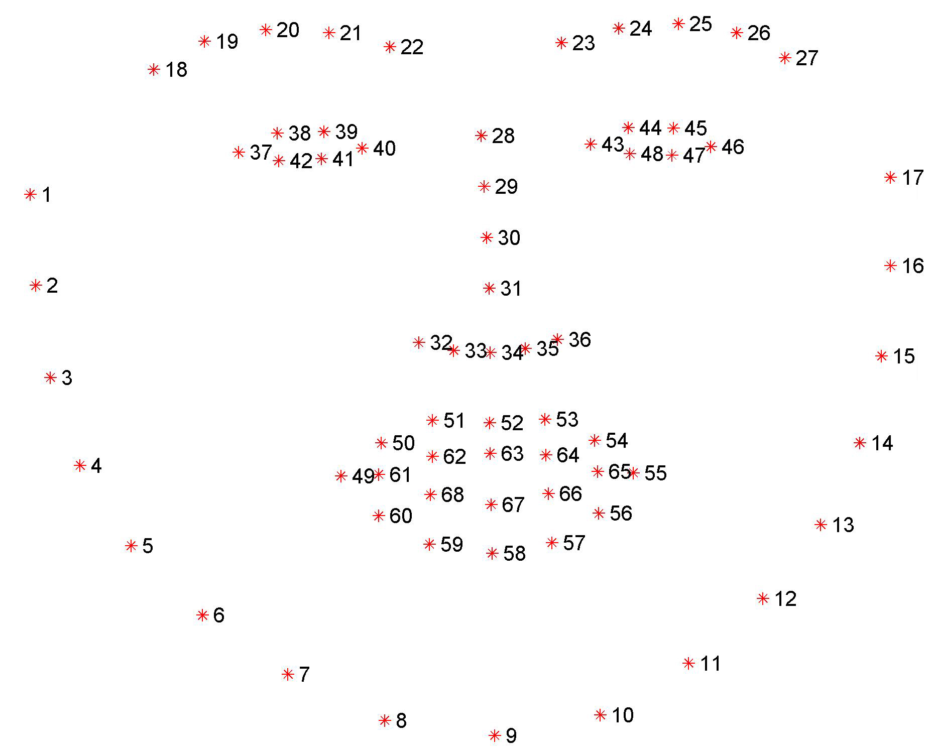
Facial Landmark Detection
We use Dlib for facial landmarks detection.
Dlib is a C++ CUDA enabled library.
Dlib library is a well-built library containing various image processing and Machine Learning based algorithms with proper documentation.
68 unique landmarks are pre-defined on the face which makes it fast and easy to detect/recognize and track in the live video.
Notes:
Tejas

Slide 20

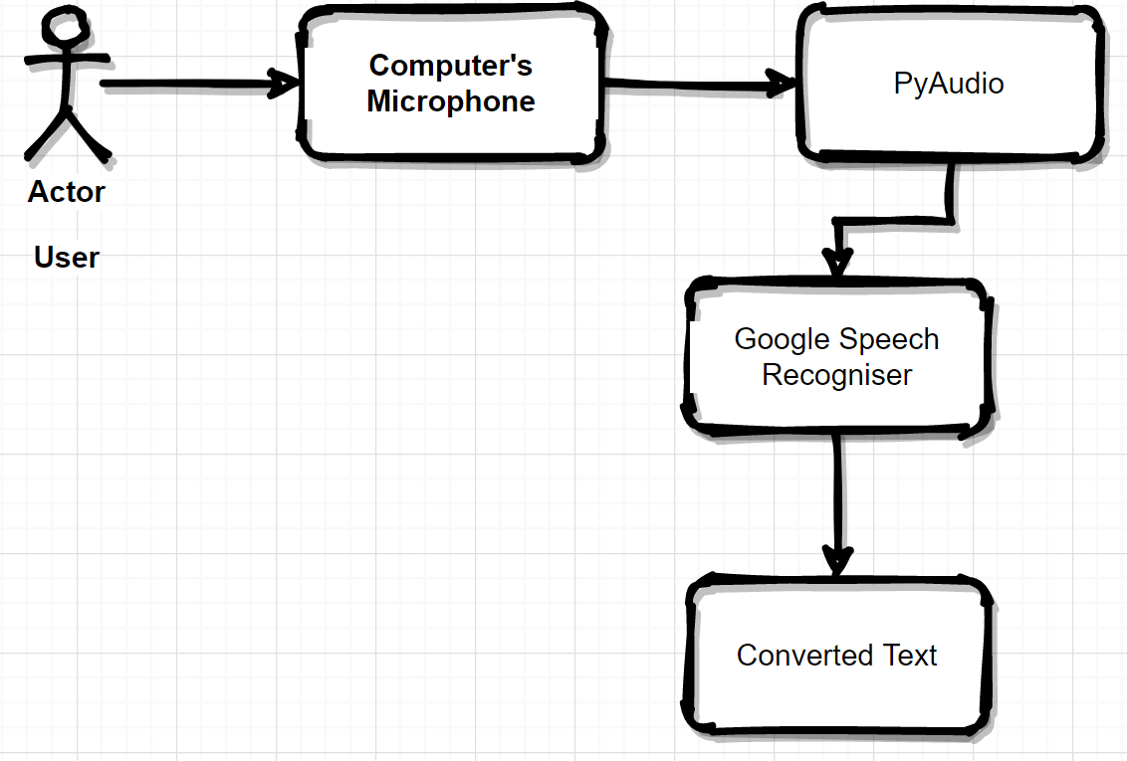
Speech Recognition
Once the robot is called for, it records the users voice until the user stops speaking.
Once the speech is recorded, it gets converted to text and this text is compared to the user's pre-loaded commands to activate the further corresponding actions.
Notes:
Tejas

Slide 21
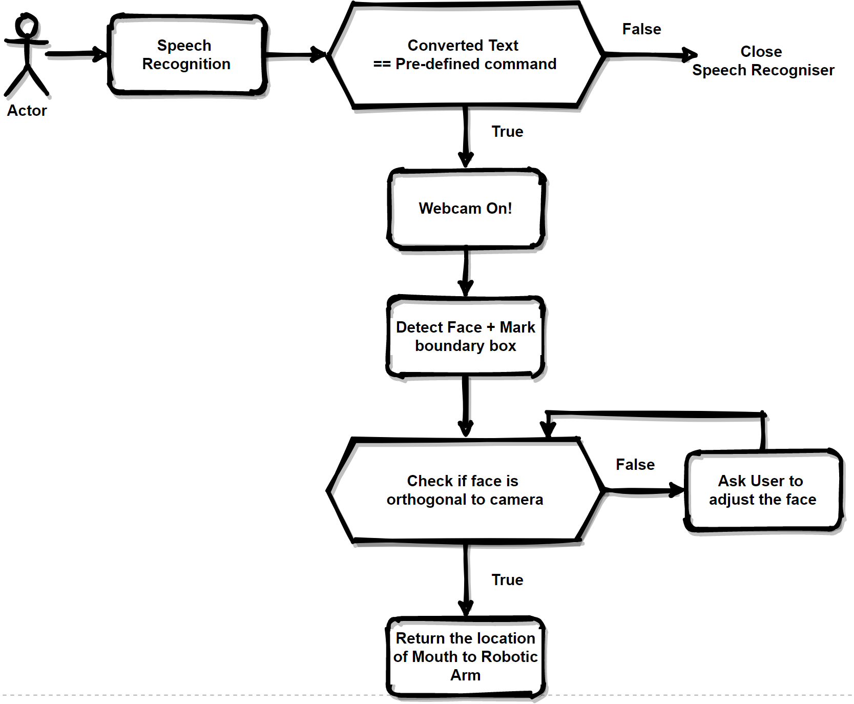
Algorithm
Once the webcam is on, every frame is captured and converted to gray scale 2D image.
Landmarks (28, 8) are used to draw straight line to measure the face tilt angle.
If angle is ~90 degrees to x-axis. Then, landmark (66) locations are returned to the robotic arm for mask placement
Notes:
Tejas

Slide 22
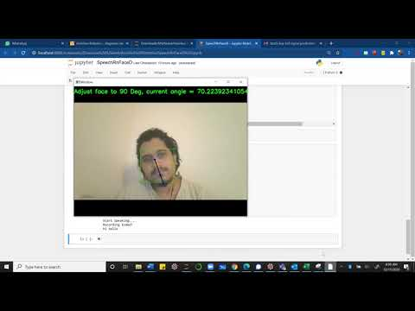
Demo - Facial Recognition
Notes:
Tejas

Slide 23
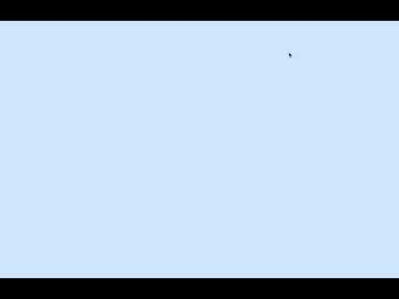
Demo – Mask Placement

Slide 24
Shortcomings
The simulated camera is limited in its ability to pinpoint 3D coordinates on a simulated face.
A real camera scanning a real face would not have these limitations.
Notes:
Damian

Slide 25
Project Timeline
Week No. (from the day of mid-term presentation) | Tasks
1 | Design of the proposed wheelchair add-on unit and the end-effector (using SolidWorks) + Simulation of the world including the person and wheelchair
2 | Implementation of facial recognition algorithm
3 | Implementation of path planning and obstacle avoidance algorithm for the robotic arm
4 | Implementation of speech recognition for Human-Robot interaction
5 | Manufacturing the unit (includes 3-D printing and other techniques)
6 | Installing all the new add-ons onto a wheelchair and testing
7 (Dec 11th- Final presentation) | Re-work based on the test results and Final presentation

Slide 26
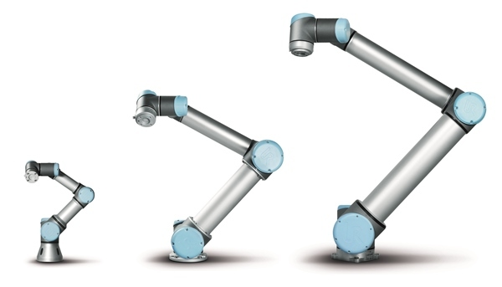
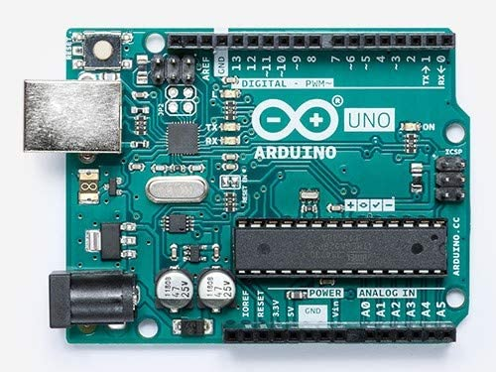
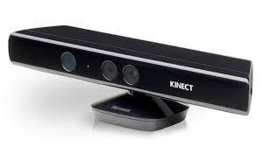
Future Work
Implementing to hardware:
Mobile platform: wheelchair
Robotic arm: Jaco robot
End Effector: 3D Printing
Sensors: 3D camera, touch sensor, etc.
Control Core: Raspberry Pi
Control Interface: a console/button based on Arduino
Notes:
Damian

Slide 27
Hardware Design
Mobile platform: wheelchair
Robotic arm: Jaco robot
End Effector: 3D Printing
Sensors: 3D camera, touch sensor, etc.
Control Core: Raspberry Pi
Control Interface: a console/button based on Arduino

Slide 28
References
Erickson, Zackory, et al. “Assistive Gym: A Physics Simulation Framework for Assistive Robotics.” ArXiv:1910.04700 [Cs], Oct. 2019. arXiv.org, http://arxiv.org/abs/1910.04700.
Ruiz, Nataniel, et al. “Fine-Grained Head Pose Estimation Without Keypoints.” ArXiv:1710.00925 [Cs], Apr. 2018. arXiv.org, http://arxiv.org/abs/1710.00925.
GE Additive Community Face Mask Frame | NIH 3D Print Exchange. https://3dprint.nih.gov/discover/3dpx-013512. Accessed 19 Oct. 2020.
Lei, Z., Yang, J., & Zhuang, Z. (2014). A Novel Algorithm for Determining Contact Area Between a Respirator and a Headform. Journal of Occupational and Environmental Hygiene, 11(4), 227–237. doi:10.1080/15459624.2013.858818
Saraiji, MHD Yamen, et al. “Fusion: Full Body Surrogacy for Collaborative Communication.” ACM SIGGRAPH 2018 Emerging Technologies, ACM, 2018, pp. 1–2. DOI.org (Crossref), doi:10.1145/3214907.3214912.
Verburg, Gerbrand, et al. “Manus: The Evolution of an Assistive Technology.” Technology and Disability, vol. 5, no. 2, Oct. 1996, pp. 217–28. DOI.org (Crossref), doi:10.3233/TAD-1996-5209.
Loughran, Sean. “Alternative Ways to Control a Power Wheelchair.” ATandMe, 31 July 2015, https://www.atandme.com/?p=950.

Slide 29


Slide 30
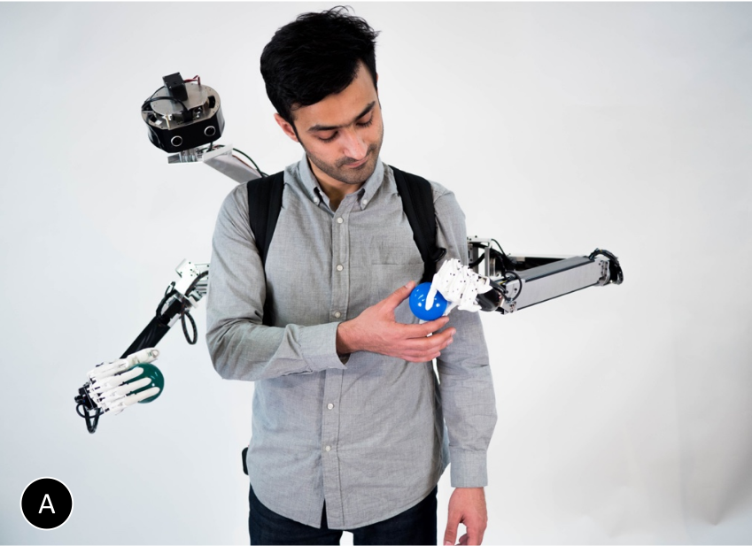
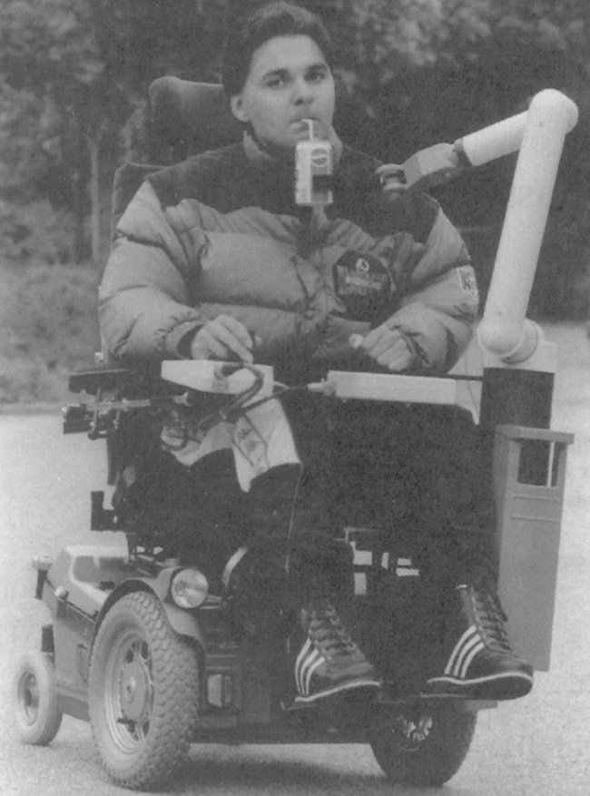
Arm Component
Robot arm mounted to wheelchair
Different options for the mount point
N-DoF – still to be determined based on mount point and desired workspace
Figure 1. Related work from Saraiji et al. 2018.
Figure 2. Early wheelchair-mounted arm prototype (circa 1996)

Slide 31
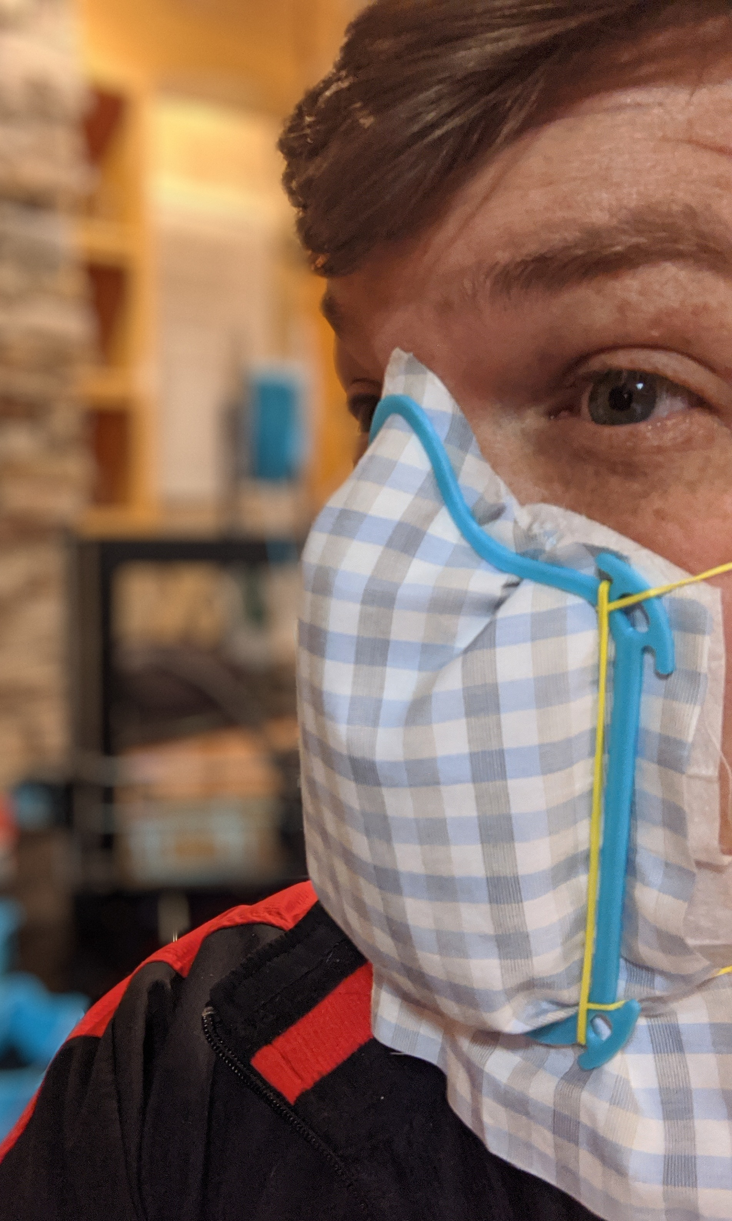
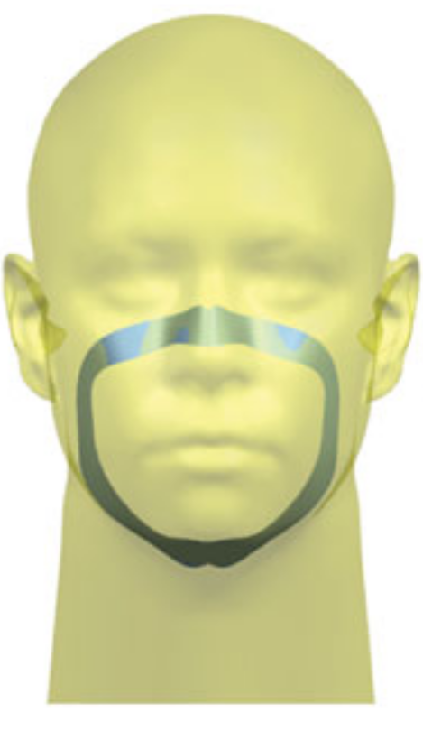
Mask End Effector
Custom end effector that holds a standard (N95) mask
Frame made of metal or plastic with clips to fix the mask in place
Minimal contact with the user's face
Figure 3. Similar idea for mask frame, but in our case, attached to the robot arm
Figure 4. Contact area between average human face and N95 mask.

Slide 32
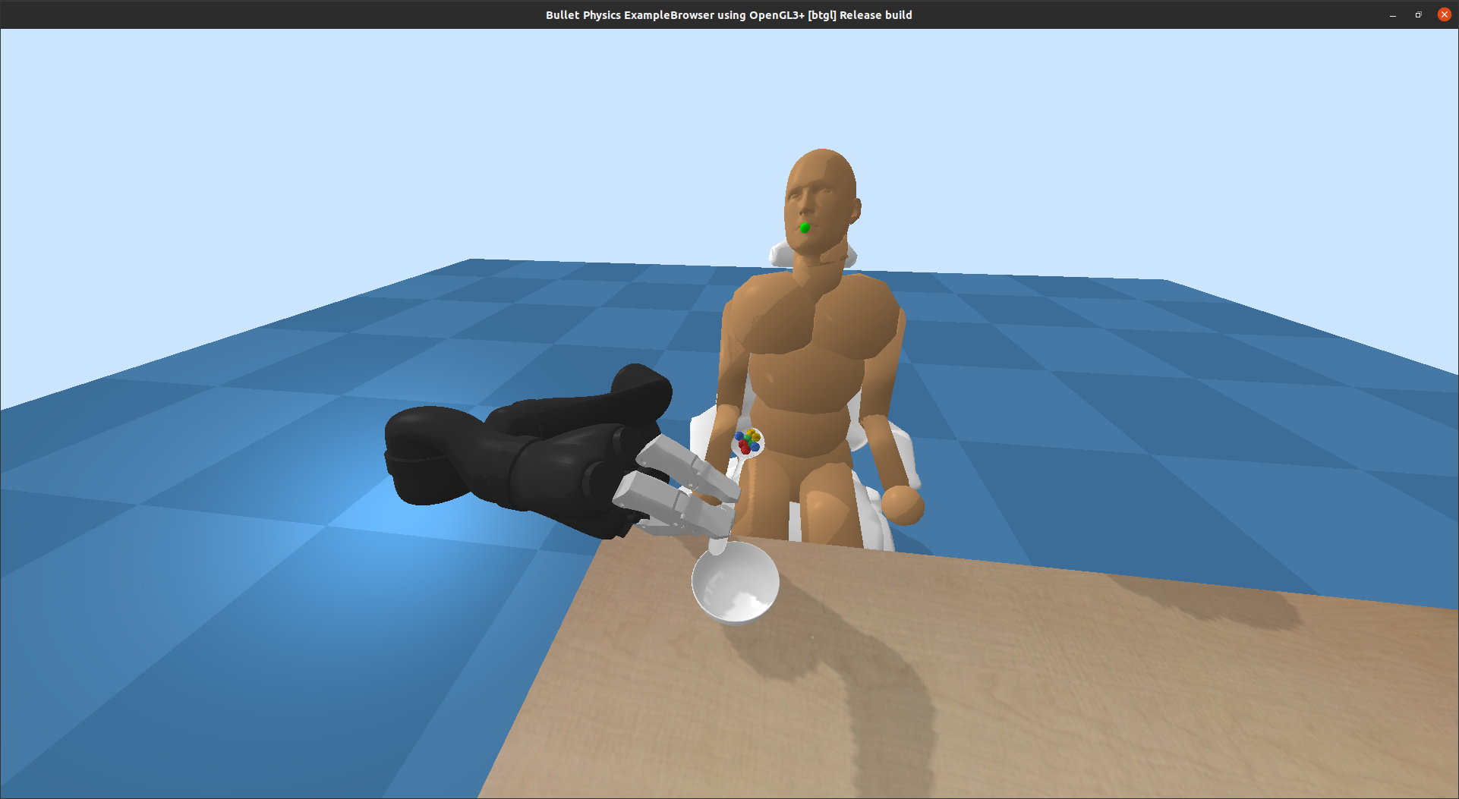
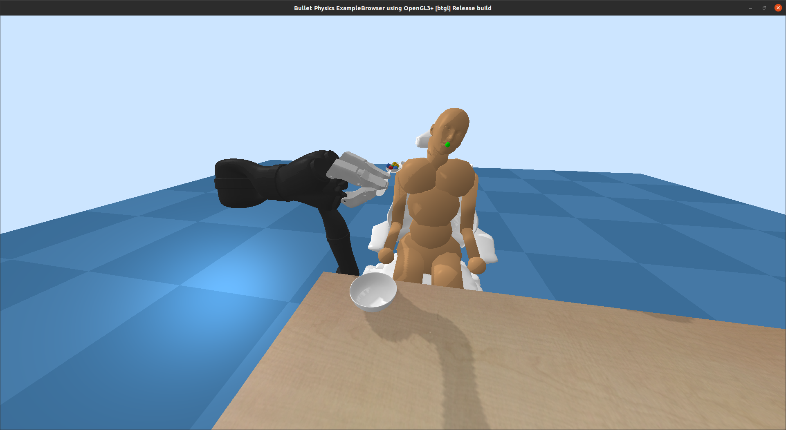
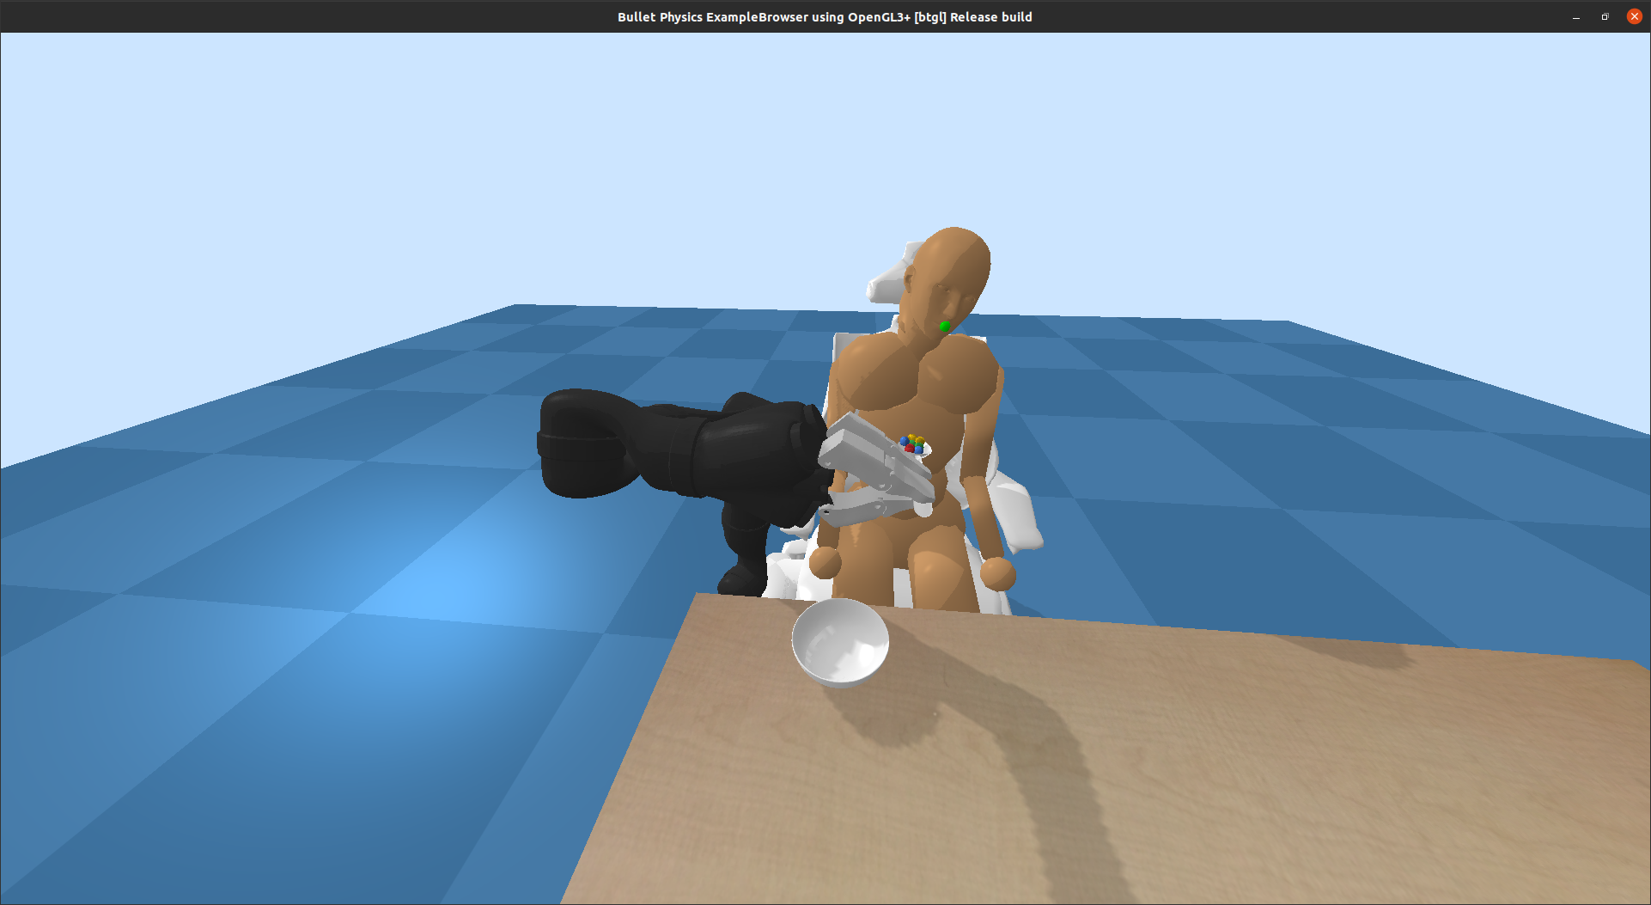
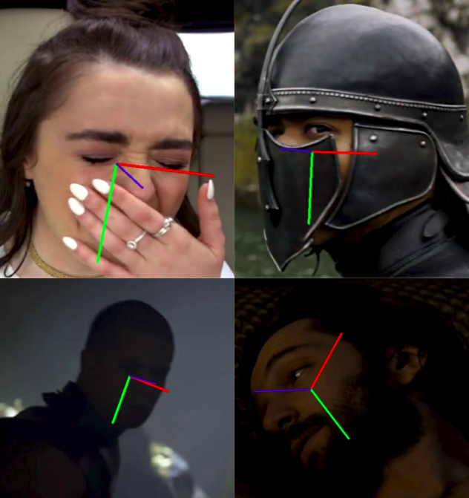
Face Recognition System
Camera mounted on wheelchair pointed to user's face
Determine head position and orientation in world frame
Use existing ML algorithms for pose estimation
Figure 5. Possible head orientations expected (Erickson et al. 2019)
Figure 6. Head pose estimation from trained CNN (Ruiz et al. 2018)

Slide 33



Methodology - Software Design
Face Recognition: OpenCV
Machine learning: PyTorch
Robot Control: ROS
Programming Languages: Python, C/C++

Slide 34
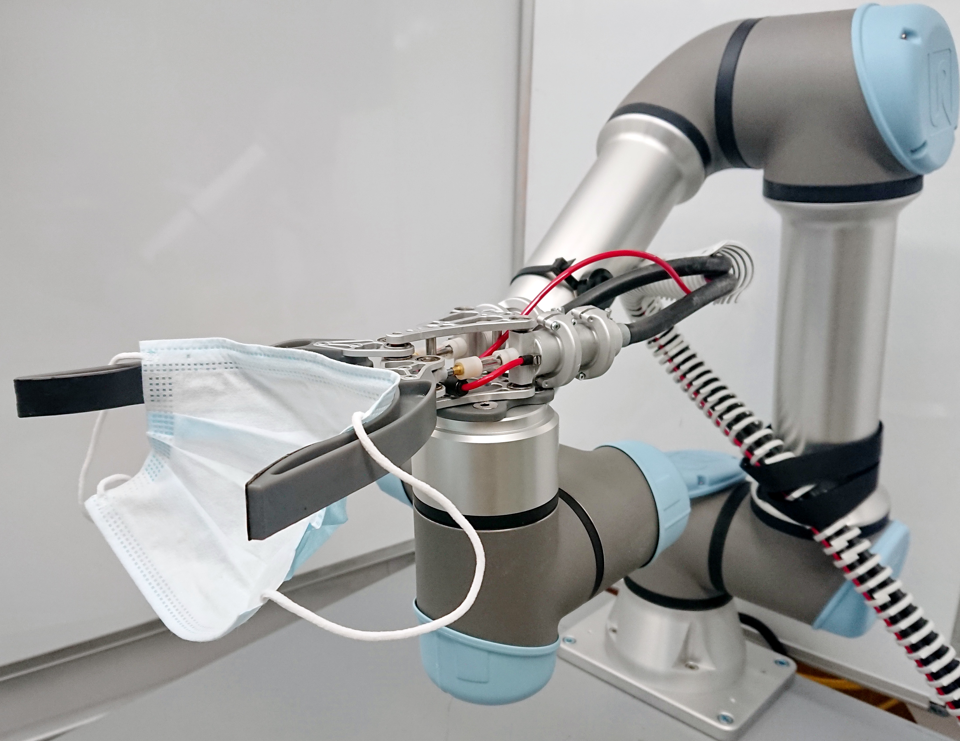
Methodology
Software Design
Simulation
Hardware Design
(Taken by Xinchao Song in the Northeastern robotics lab at ISEC)

Slide 35
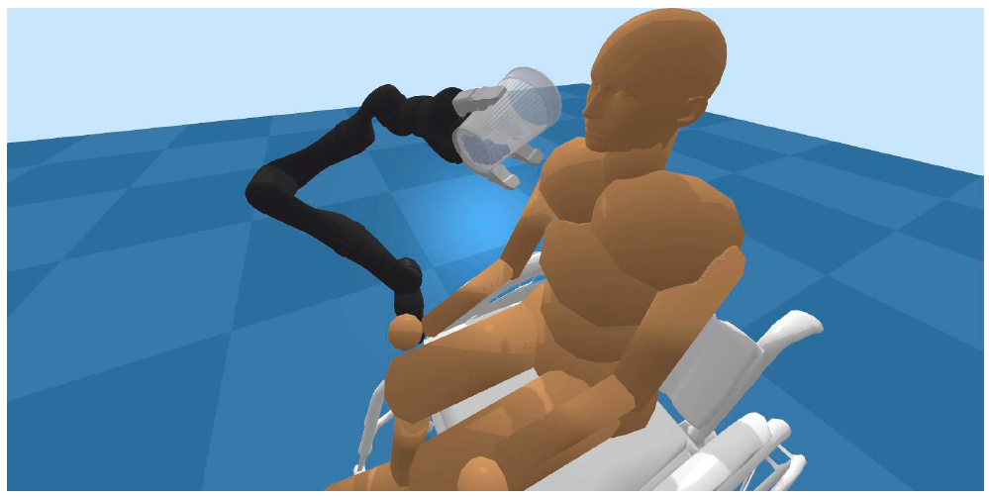
Methodology - Simulation
PyBullet/MuJoCo
(From Erickson, Zackory M. et al. “Assistive VR Gym: Interactions with Real People to Improve Virtual Assistive Robots.” 2020 29th IEEE International Conference on Robot and Human Interactive Communication (RO-MAN) (2020): 299-306.)

Slide 36
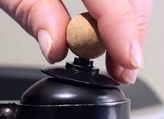
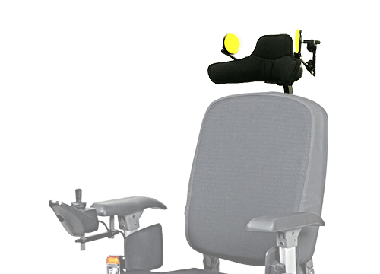
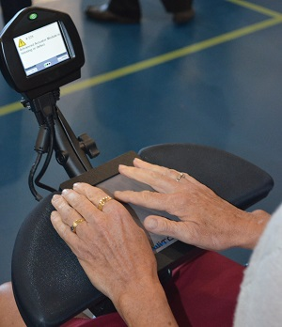
Control Interface
Different options for control input, depending on the user's capabilities (joystick, touchpad, voice, etc.)
Initial choice is a touch interface (button) as part of project deliverables
Figure 7. Various interfaces for wheelchair-bound users

